Slide 1
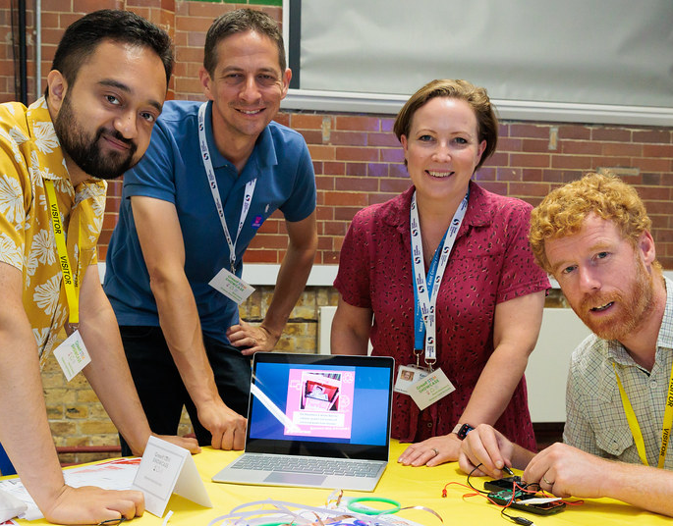
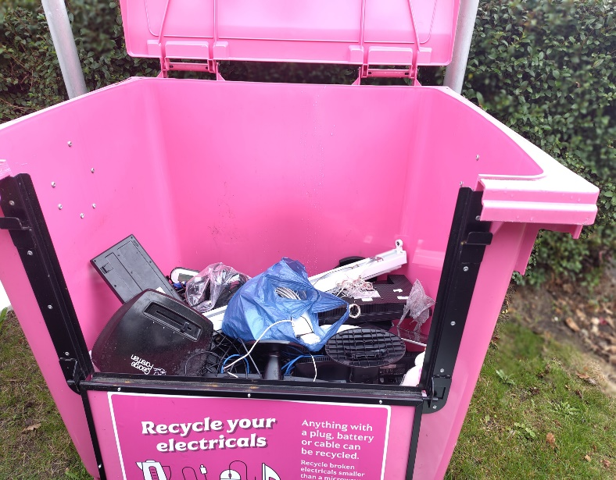
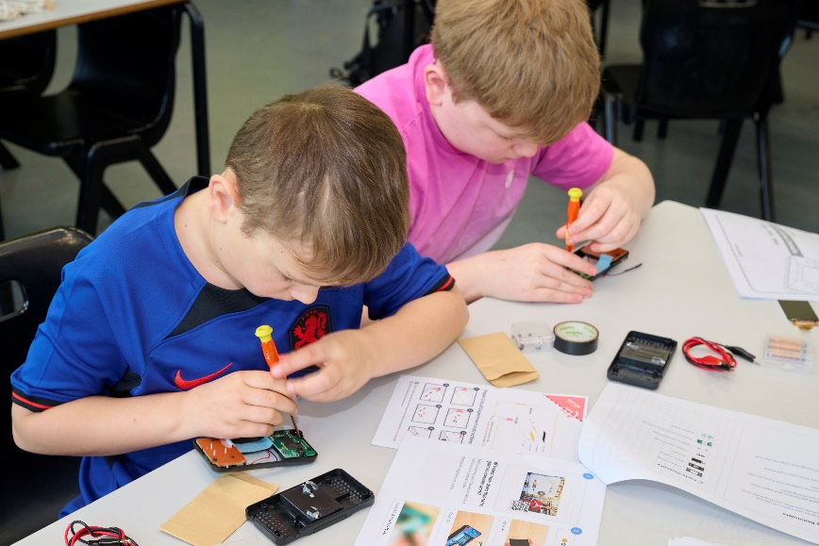
e-Waste Warriors
Engagement
Repair
Recycling

Slide 2


Overview
Material Focus Innovation Fund
£50,000
1 year project

Slide 3
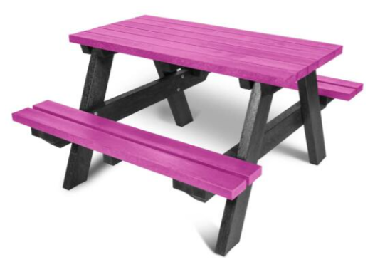
The Project
6 four-week mini cluster projects across localised areas
Each cluster – 2-3 secondary and 1-5 primary schools (5-7 schools)
Assembly to launch in each school
2 x bins at each school
1 year group from each school received Team Repair engagement and skills sessions
All schools received Recycle Your Electricals branded comms.
Repair event in each cluster
Cluster competition

Slide 4
Aims
Increase WEEE recycling rates in Kent
Increase WEEE repair rates in Kent
Increase awareness of repair and repair cafes
Develop relationships between schools and repair cafes
Encourage engagement among school aged students and their families in recycling and repair

Slide 5

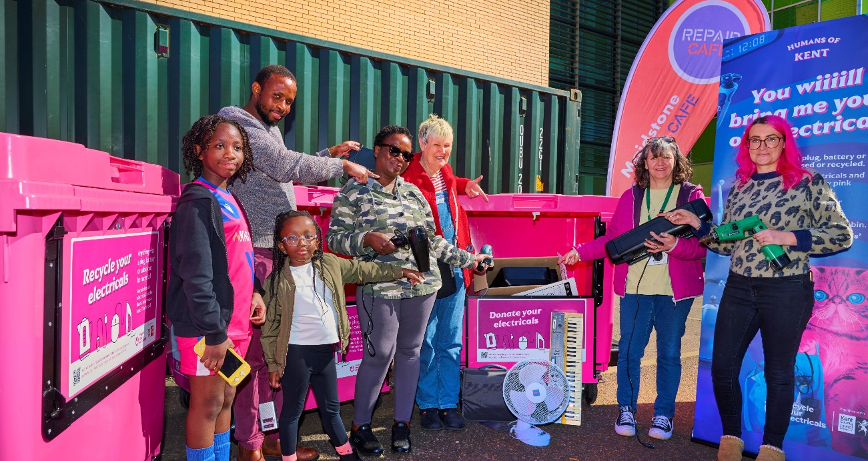
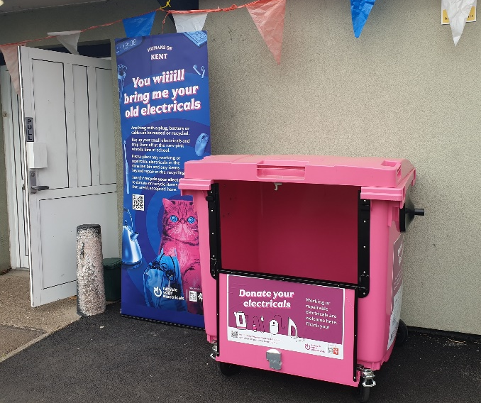
The Bins!

Slide 6
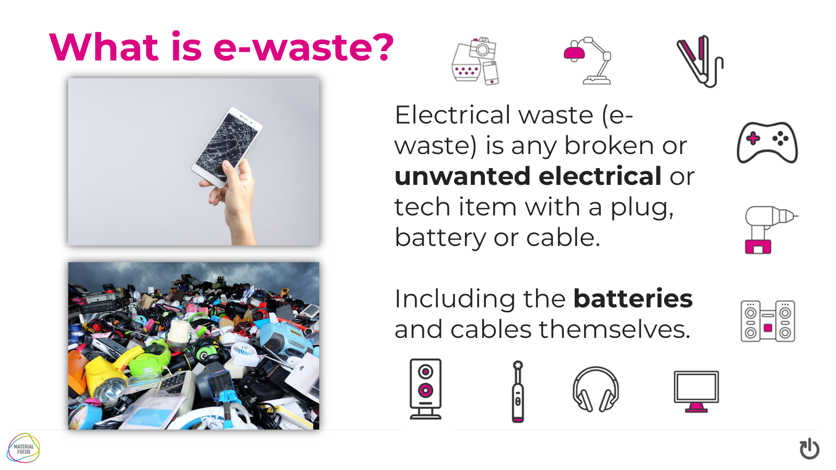
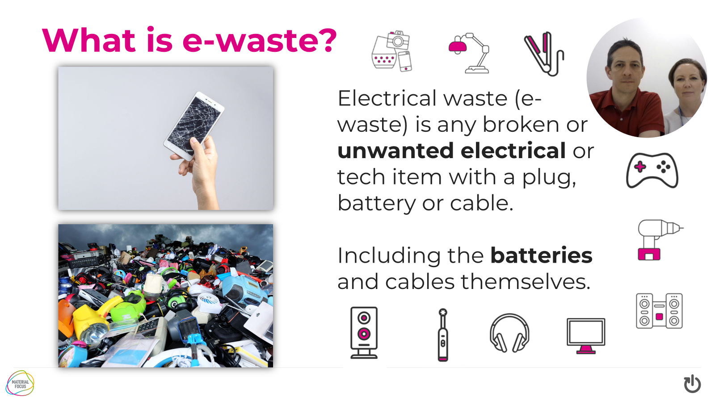
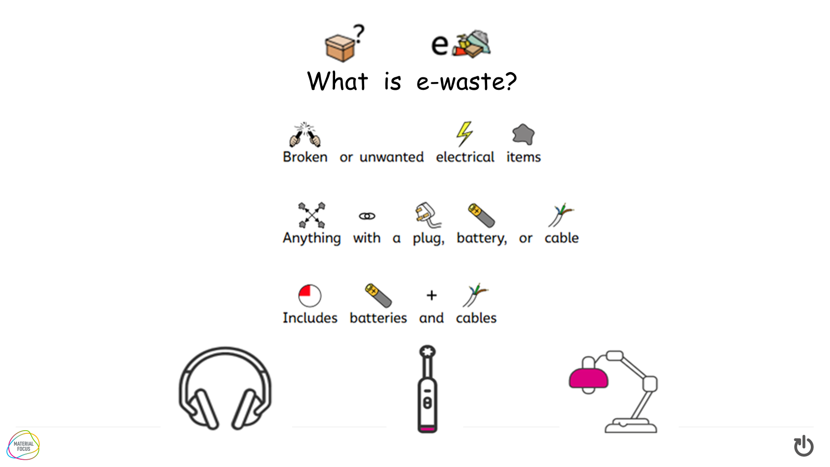
Assemblies

Slide 7

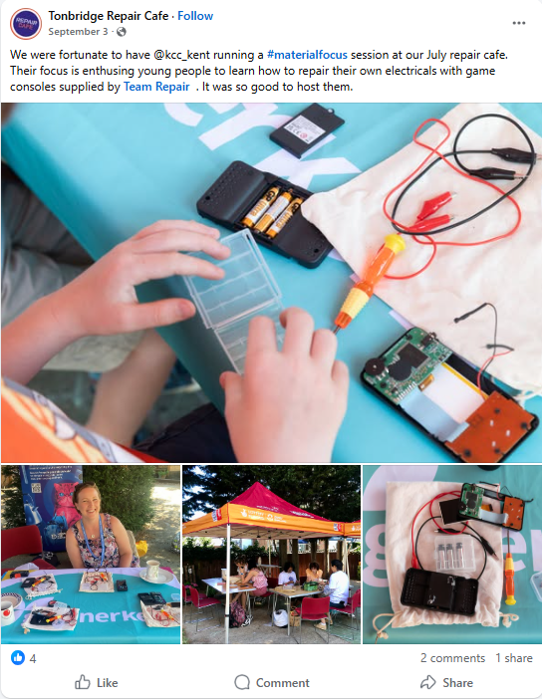
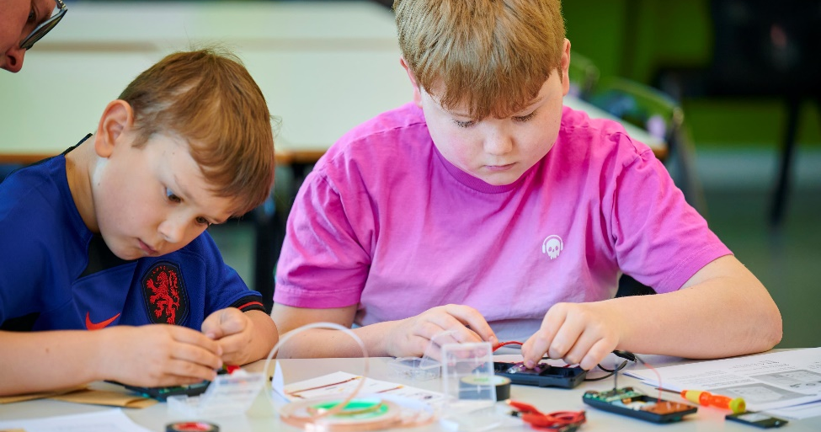
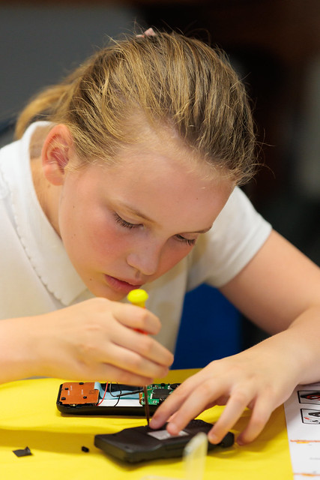
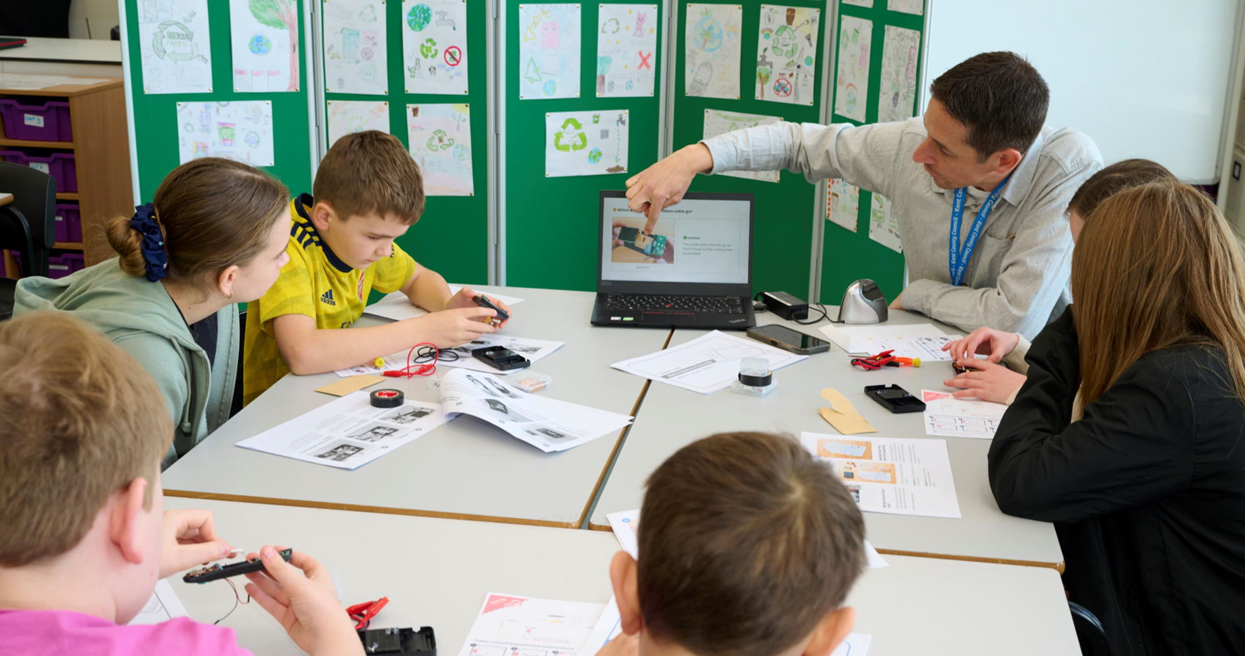

Slide 8
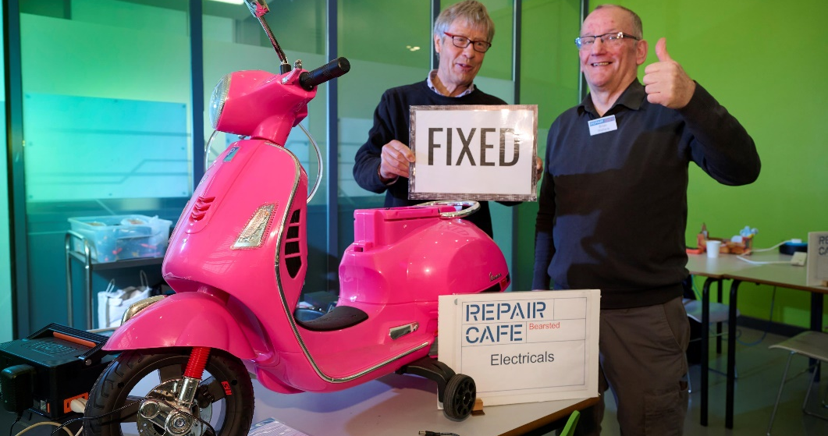
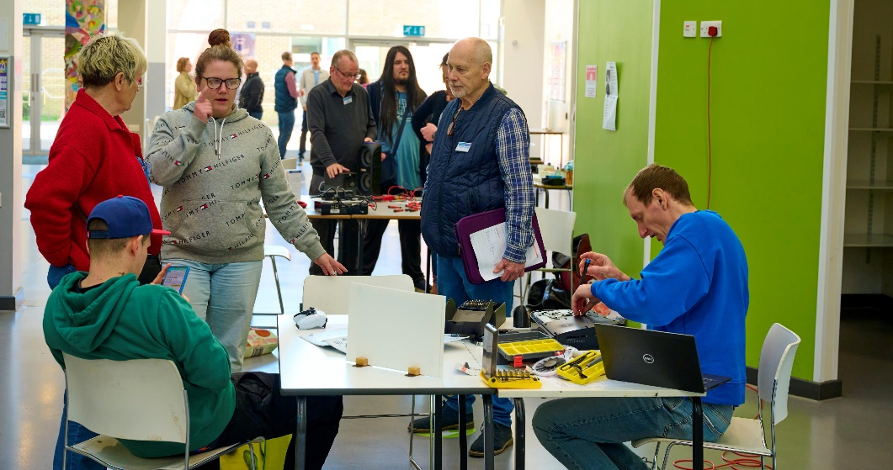
Repair cafés and events
Maidstone – in school

Slide 9
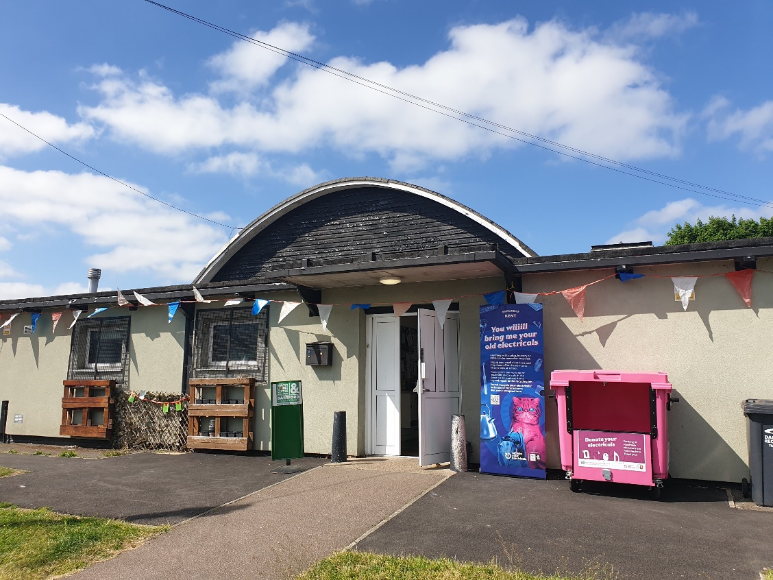
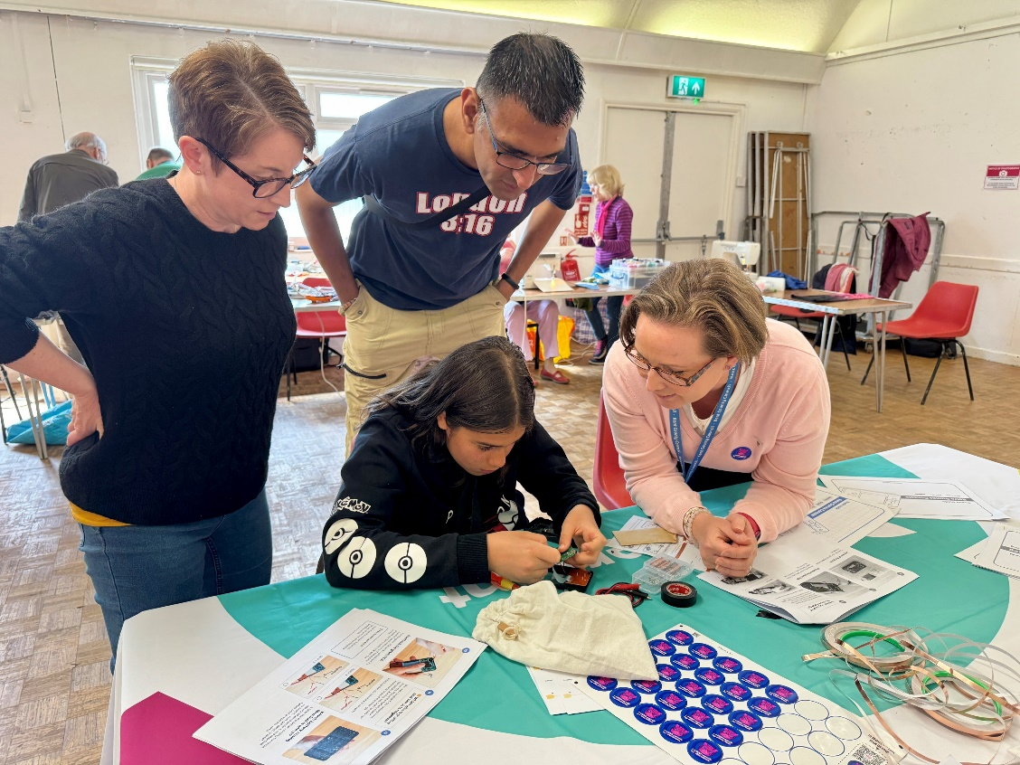
Dartford Repair Café, stand alone event

Slide 10
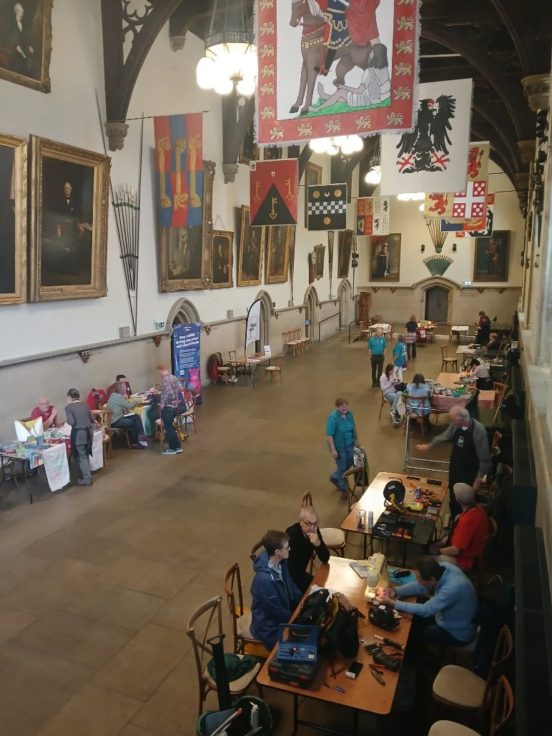
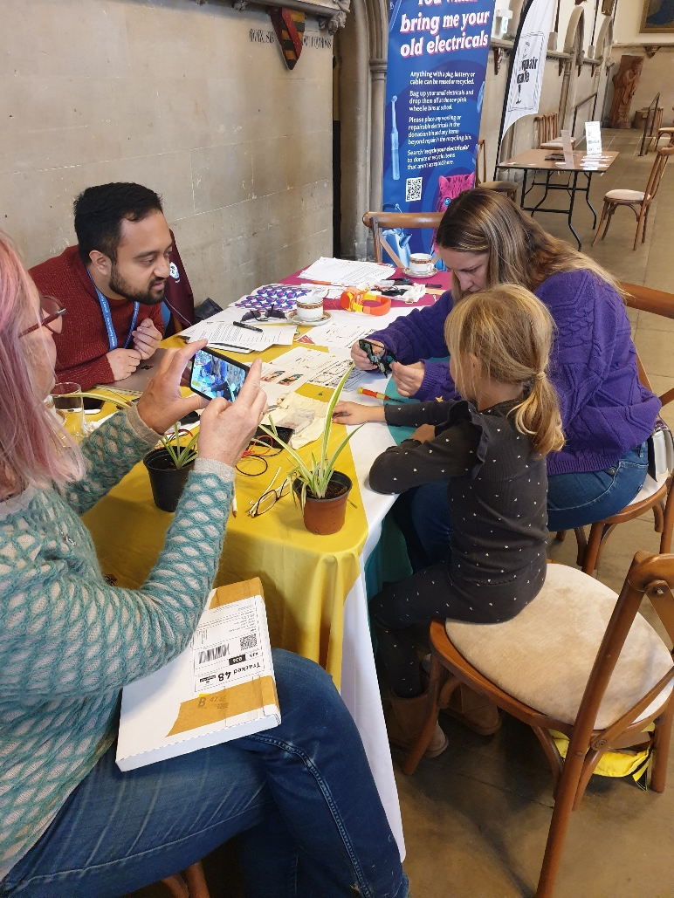
Maison Dieu,
Dover Repair Cafe

Slide 11
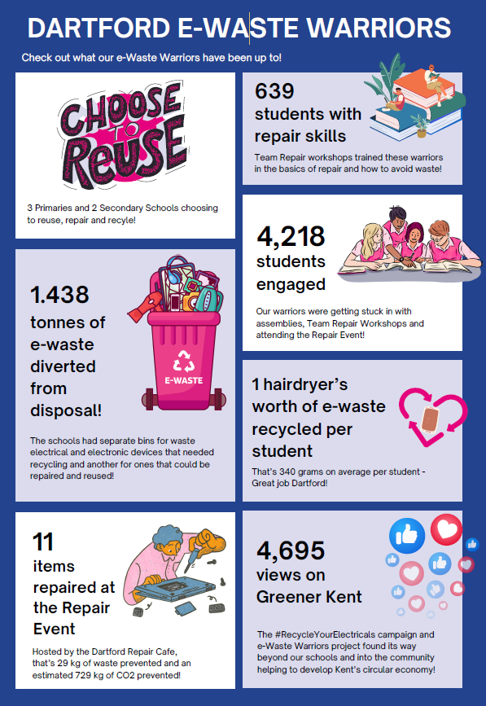
Results
36 schools
21,210 students reached in assemblies
3,619 students engaged and trained with Team Repair kits
5.09 tonnes of e-waste collected – (more to come)
Over 100 items fixed at repair cafes*
TBC electricals donated*

Slide 12
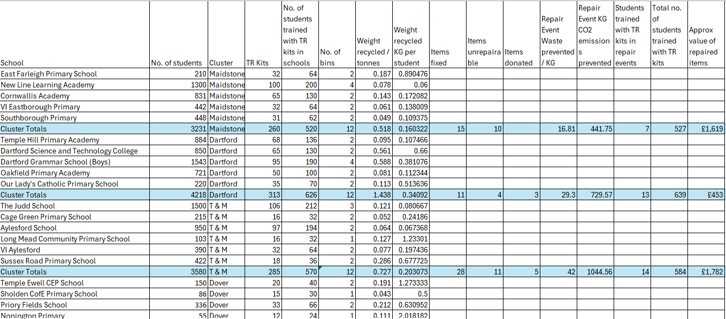

Slide 13
WWW (What Went Well)
“This project was amazing! It helped show how recycling is for more than just paper and engaged our children no end!”
“The repair cafe event was really lovely - to see our school involved in a community project”
“Being an e-Waste Warrior shows children they can be changemakers of the future”
Excellent feedback from schools
Over delivered on number of schools and students
Local recycling rates increased
Kent-wide recycling rates increased
Enlisting schools through CYPE Team
Schools have used it as a platform for sustainability and climate action plan initiatives e.g. work experience and STEM sessions at repair cafes
Team Repair sessions were a real hit – smaller schools who had a higher % of students training on the kits had a much higher recycling rate per student
Presenting at Kent Green School Awards and Kent Green STEM event opened doors and networking opportunities

Slide 14
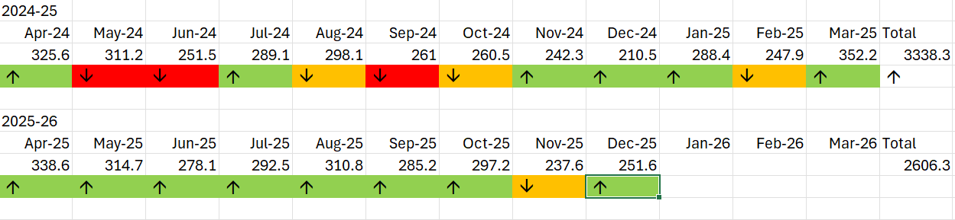
Kent Data

Slide 15
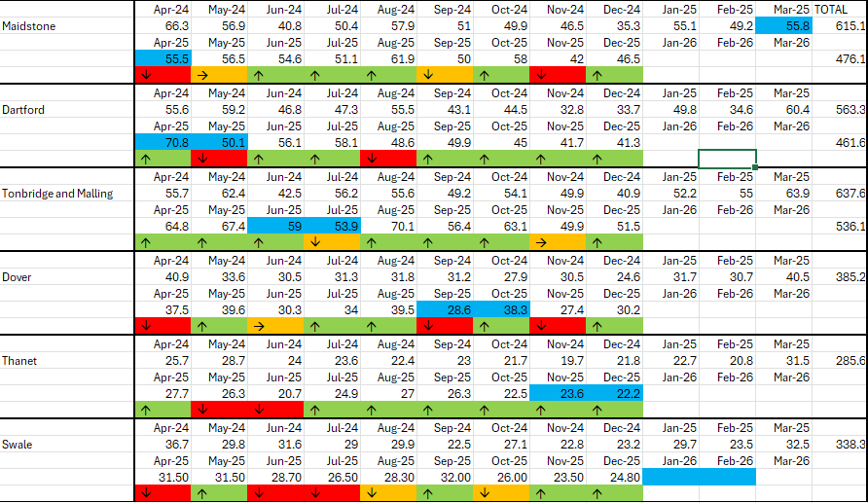

Slide 16
EBI (Even Better If)
Secondary schools had performed similarly to primaries
Bin movements were initially expensive and hard work!
Tonnage was less than anticipated – did we over-estimate?
Schools could be relied upon to respond to communications, read and use all the materials we supplied
Repair events were attended by more students
Donated items were labelled or conspicuous and the correct bins were always used

Slide 17
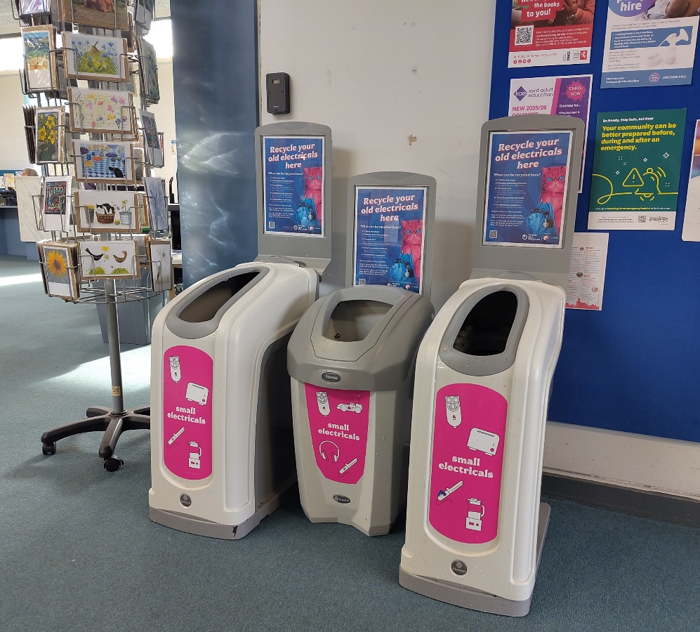
Legacy and Future
Libraries – recycling and electrical safety
Schools – recycling and reuse
Repair in schools – individual repair events
Repair cafes doing skills training
Schools – work exp. sustainability etc.
RCs and schools - collaboration

Slide 18

Questions?

