Slide 1
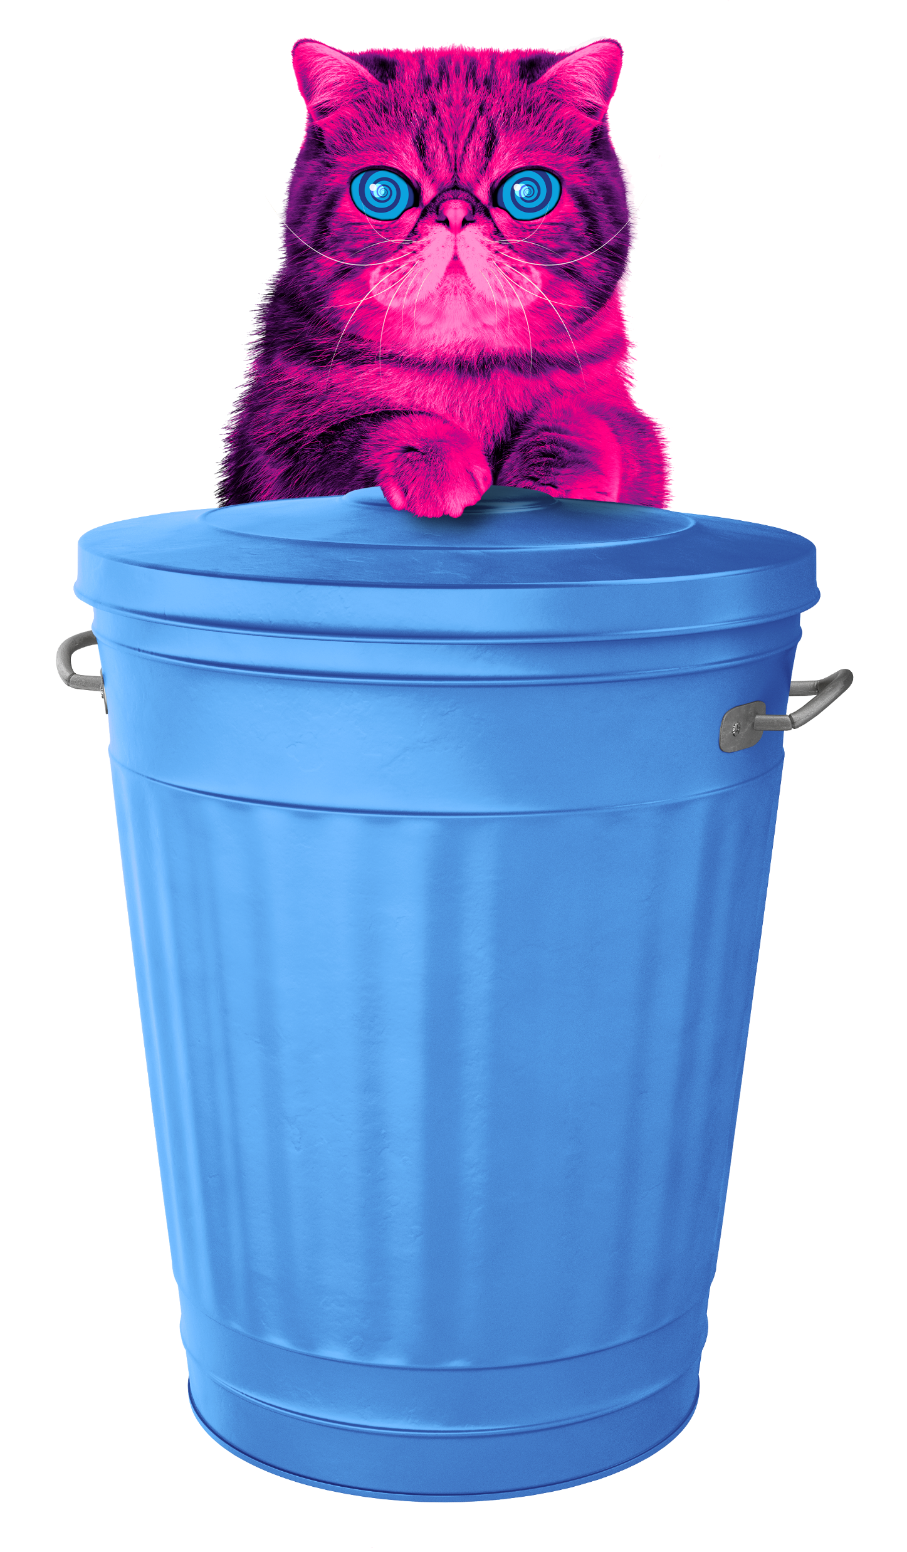
WEEE
Waste electricals and electronic equipment

Slide 2


e-Waste Warriors
Thanet Cluster
19th January to 13th February 2026
Rich Izzard​
Senior Circular Economy Officer​
Kent County Council

Slide 3
Agenda
What is e-waste?
What are the problems?
How does electrical recycling work? Hypnocat video
What can be recycled?
What is inside electricals?
What can you do to help with e-waste?

Slide 4






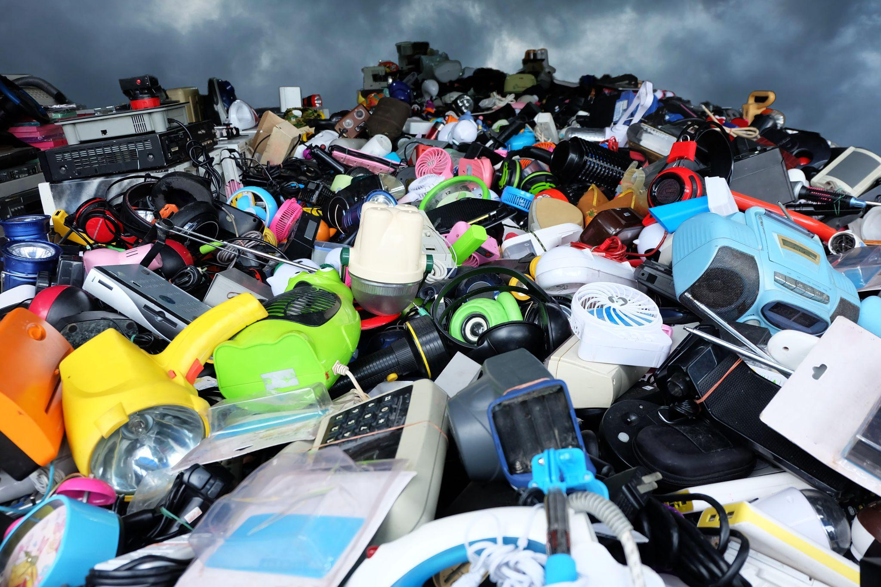





What is e-waste?
Electrical waste (e-waste) is any broken or unwanted electrical or tech item with a plug, battery or cable.
Including the batteries and cables themselves.
Notes:
Notes:
Ask the audience: So what is e-waste and why should we focus on it?
E-waste is one of the fastest growing sources of waste in the world - and in the UK!
This means we are all throwing away more and more electricals.

Slide 5
What are the issues?

Slide 6
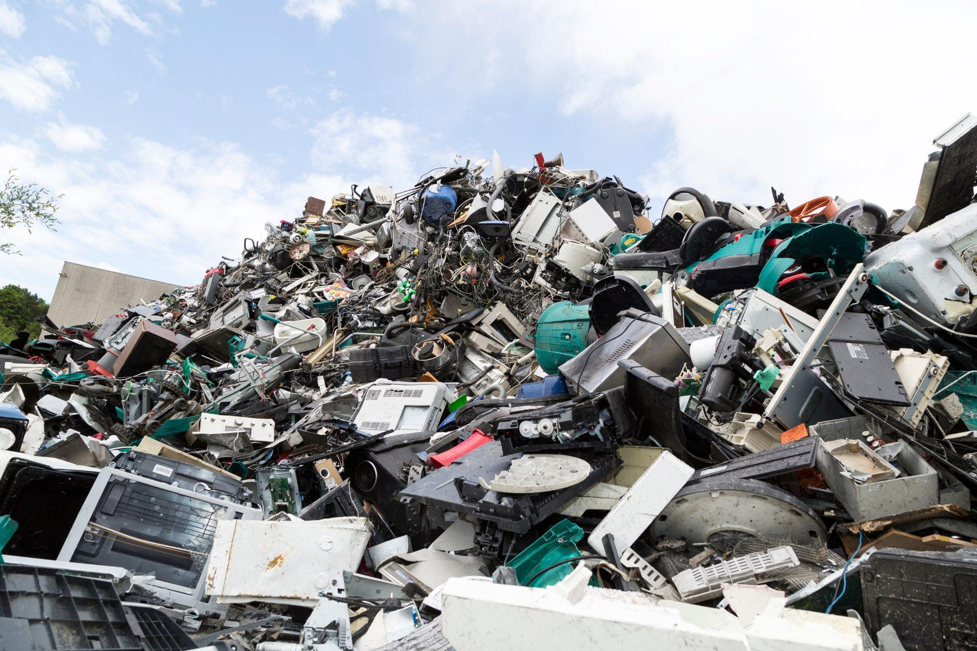
Fastest growing source of waste
Notes:
Notes:
Electrical waste is the fastest growing sources of waste in the world, and in the UK.
It’s growing faster than fast fashion.
That is why we are here to get the UK reusing, repairing, donating and recycling their old unwanted electricals.

Slide 7

Precious resources lost forever
Notes:
Notes:
Lost resources
As we mentioned before electricals are made up of different parts and components.
Electricals contain valuable materials such as copper, iron, gold, platinum and palladium
If old electricals go to landfill, or are flytipped instead of being recycled, valuable resources are lost forever. That’s a big problem.
Discarded or hoarded household electricals cost the UK economy £370 million per year of lost valuable raw materials
When the raw materials of batteries are recovered, they can be reused for other purposes or to make new things. For example, the lithium in some batteries could power thousands of electric cars!

Slide 8

Environmental damage
Notes:
Notes:
When we lose those precious resources it means new materials have to be found.
This involved mining for new metals
Mining new metals creates millions of CO2 emissions which damages our environment
If we used recycled metals to make new products, 86% less CO2 emissions would be released.
Image - an example of a large open pit copper mine

Slide 9
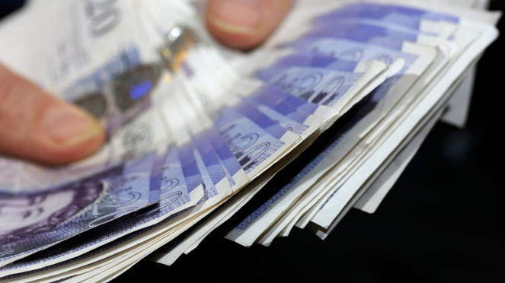
Financial loss
Notes:
Notes:
Discarded or hoarded household electricals cost the UK economy £370 million per year of lost valuable raw materials such as gold, copper, aluminium and steel.
Many electrical items that are thrown away can actually be donated
That includes your kettle, toys or laptops
The average UK household is hiding away 20 unwanted electricals
If we passed these on to charities they could make a big difference to people’s lives
Processed recycled electricals become commodities to buy and sell

Slide 10
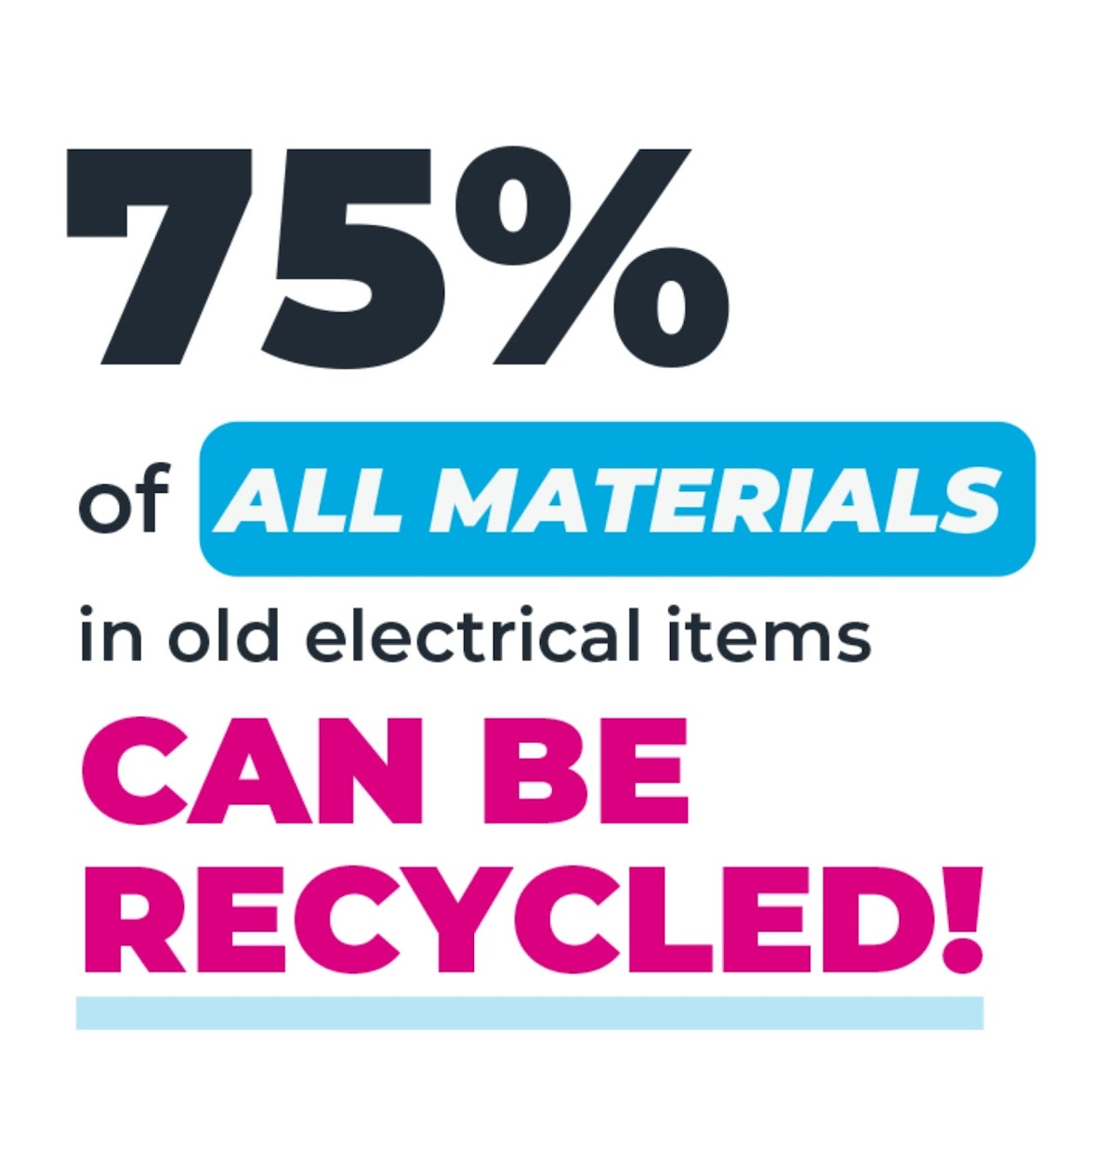

But… Anything with a plug, battery or cable can be recycled!
Notes:
Notes:
Did you know a typical iPhone contains precious metals like gold, silver, platinum, aluminium and copper!
The recycled metals from old electricals can be transformed into anything from bicycles to children’s playgrounds
Even the batteries and cables themselves can be recycled

Slide 11
How does electrical recycling work?
Notes:
We’ve got a friendly and hypnotic cat to help explain! His name is Hypnocat

Slide 12
How does electrical recycling work?
Electricals are collected
Valuable materials are separated
Metals are melted and reused
Collected
Separated
Reused

Slide 13

How

Slide 14
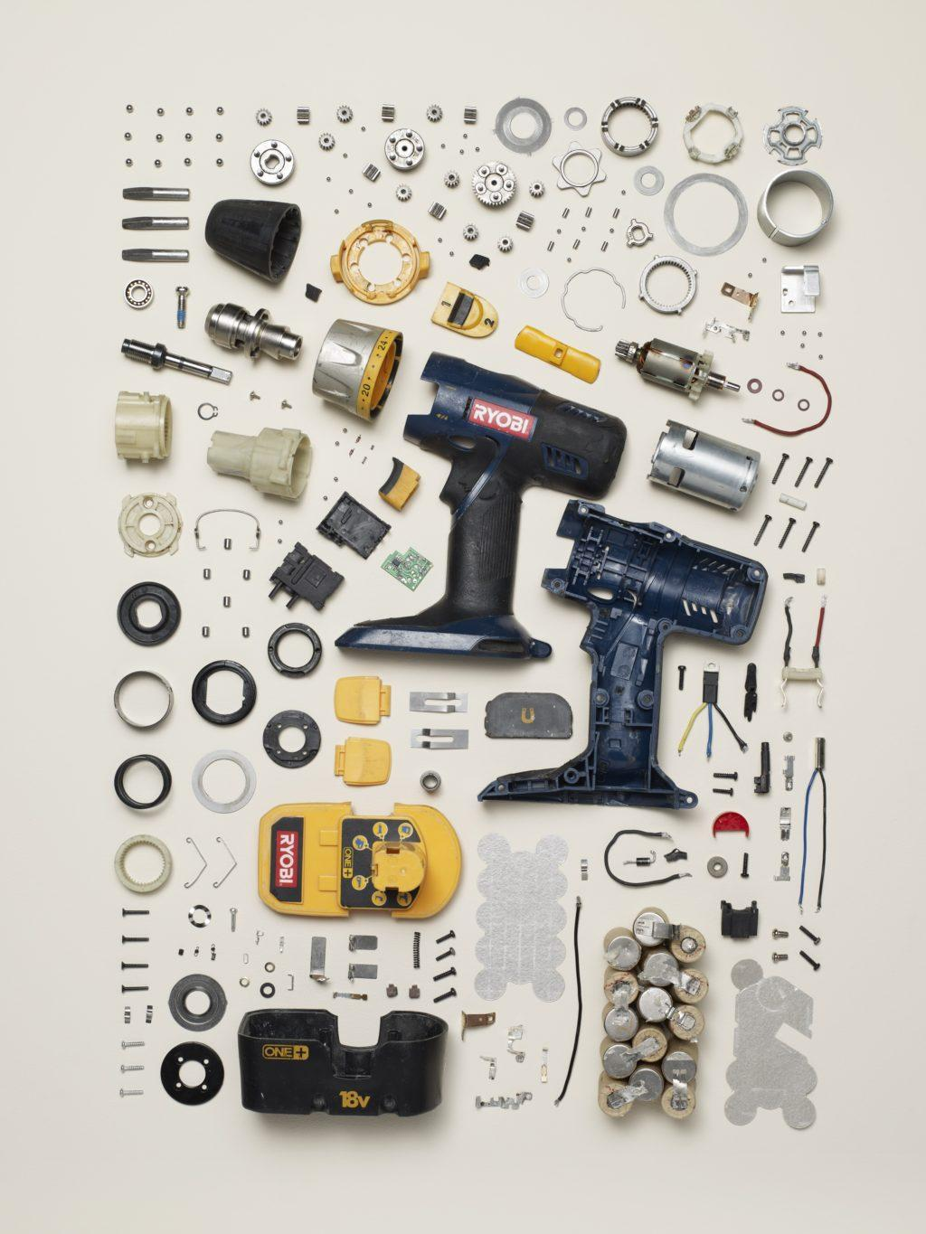
Have you ever thought about what’s inside electricals?
Gold
Copper
Aluminium
Silver
Notes:
Notes:
Electricals are made of different parts and components
Don’t try this at home!
They’re incredibly complex products, and can be made of hundreds of different parts and materials
These parts and components are made from raw materials which have often been dug up from the ground through mining
However - these precious raw materials can all be reused.
There are also batteries hidden inside electricals which we will discuss in more detail later
Image: Todd Mclellan Things Come Apart
(potential “Tear down” exercise with a few different products looking a the amount of parts they’re made of)

Slide 15

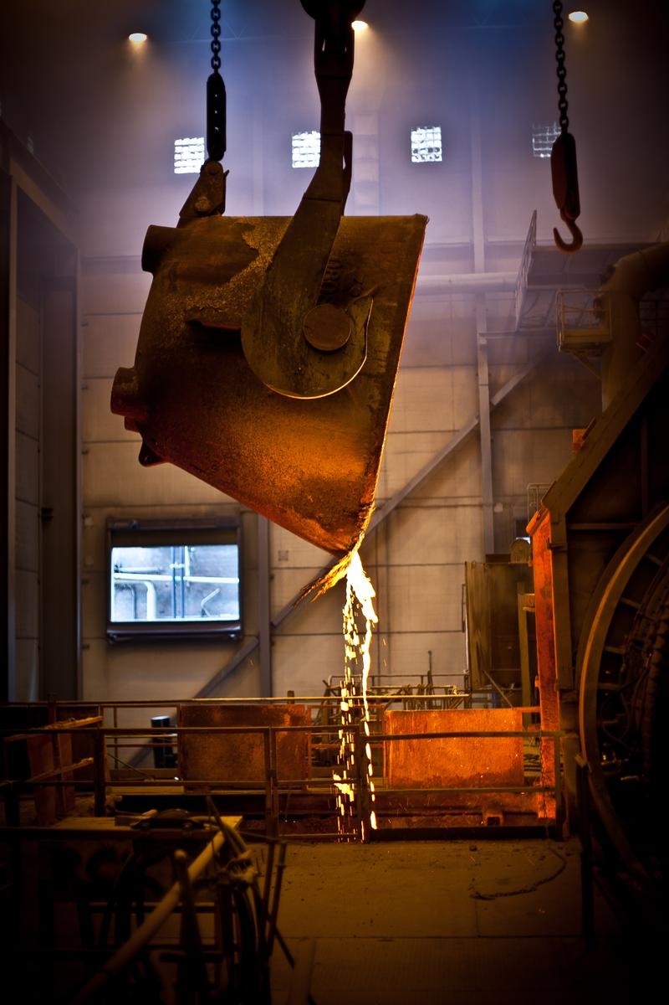
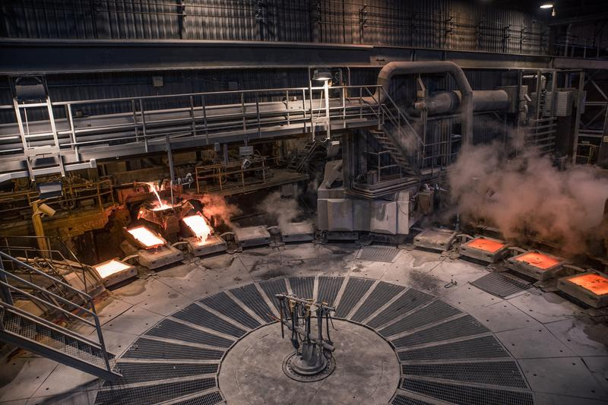
What happens to the valuable materials?
Boliden Rönnskär
Notes:
This is where most of the precious materials go, it’s called Boliden Ronnskar in Sweden.
Here, the materials are usually heated up and melted into purer forms.

Slide 16

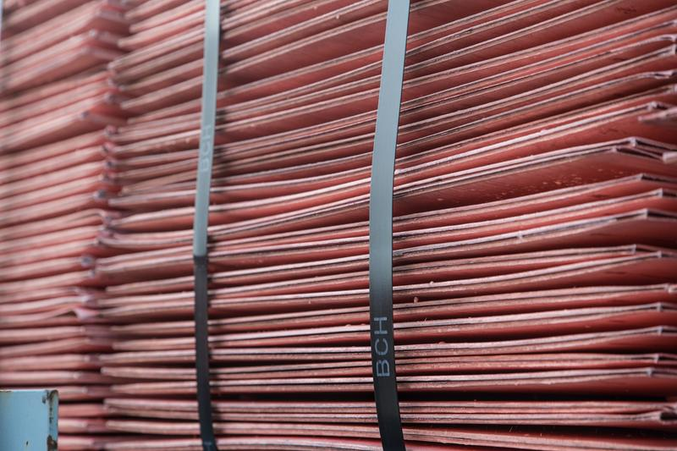
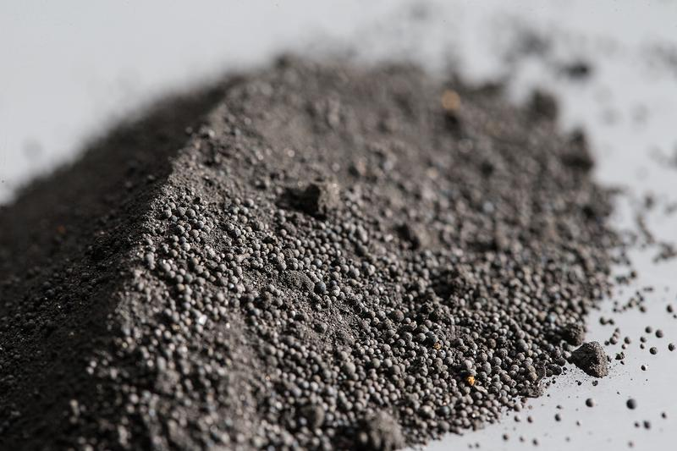
What happens to the valuable materials?
Notes:
Can you name any of the materials on this slide?
Gold, silver, copper and platinum and palladium
Now, think of all the things these are used for.

Slide 17
What can you do to help with e-waste?

Slide 18




What can you do to help?
Fix them!
Donate them!
Sell and buy second hand!
Recycle them!
Notes:
Notes:
Fix - before recycling old electrical items consider repairing them
Why?
Save money - you don’t have to buy a new one
Save resources - nothing will go to landfill
If your device has developed a fault you might be able to get the manufacturer to repair or replace it.
Use a reputable source for fixing
Failing that, remember it can be cheaper to pay to have something fixed than to buy new. Usually better for the planet too.
Donate - You might not need your old electrical item, but someone else could.
Why?
Stop items that still work from going to landfill.
It’s good for the planet, good for people - Donating is a win-win – reducing demand for raw materials, curbing CO2 emissions and giving others access to affordable goods.
Someone will thank you for it!
With so many young people digitally excluded, with no access to technology by donating your old unwanted tech you are helping bridge the divide between those excluded and who need it most
Recycle - If you can’t fix or donate it, then recycle
Why?
For all the reasons we’ve mentioned above
Save precious resources
Help the planet
Save money

Slide 19


And never bin hidden batteries…
Remove batteries if safe
Recycle batteries separately at recycle points
Never put batteries in household bins
*Batteries can cause serious injury if swallowed, please keep batteries out of reach of small children and pets. You may need assistance with the safe removal of batteries from electrical items, please ask a responsible adult to help with this.
Notes:
Notes:
So what should we do?
If the batteries can be safely removed then recycle these separately with other batteries and the item with other small electricals
You may need assistance with the safe removal of batteries from electrical items, please ask a responsible adult to help with this.
If the battery cannot be removed safely or is imbedded in the electrical device then recycle the whole thing with your old electricals
Batteries can cause serious injury if swallowed, please keep batteries out of reach of small children and pets.
Never put a battery, an electrical item containing a battery or an electrical item in your household waste or recycling bin
When a battery has been removed, store it securely and recycle it properly and promptly.
Batteries should be recycled at battery drop off points
Electricals should be recycled at an electrical drop off point
You can find these using our Recycling Locator at www.recycleyourelectricals.org.uk

Slide 20
Help your school in e-Waste Warriors

Slide 21
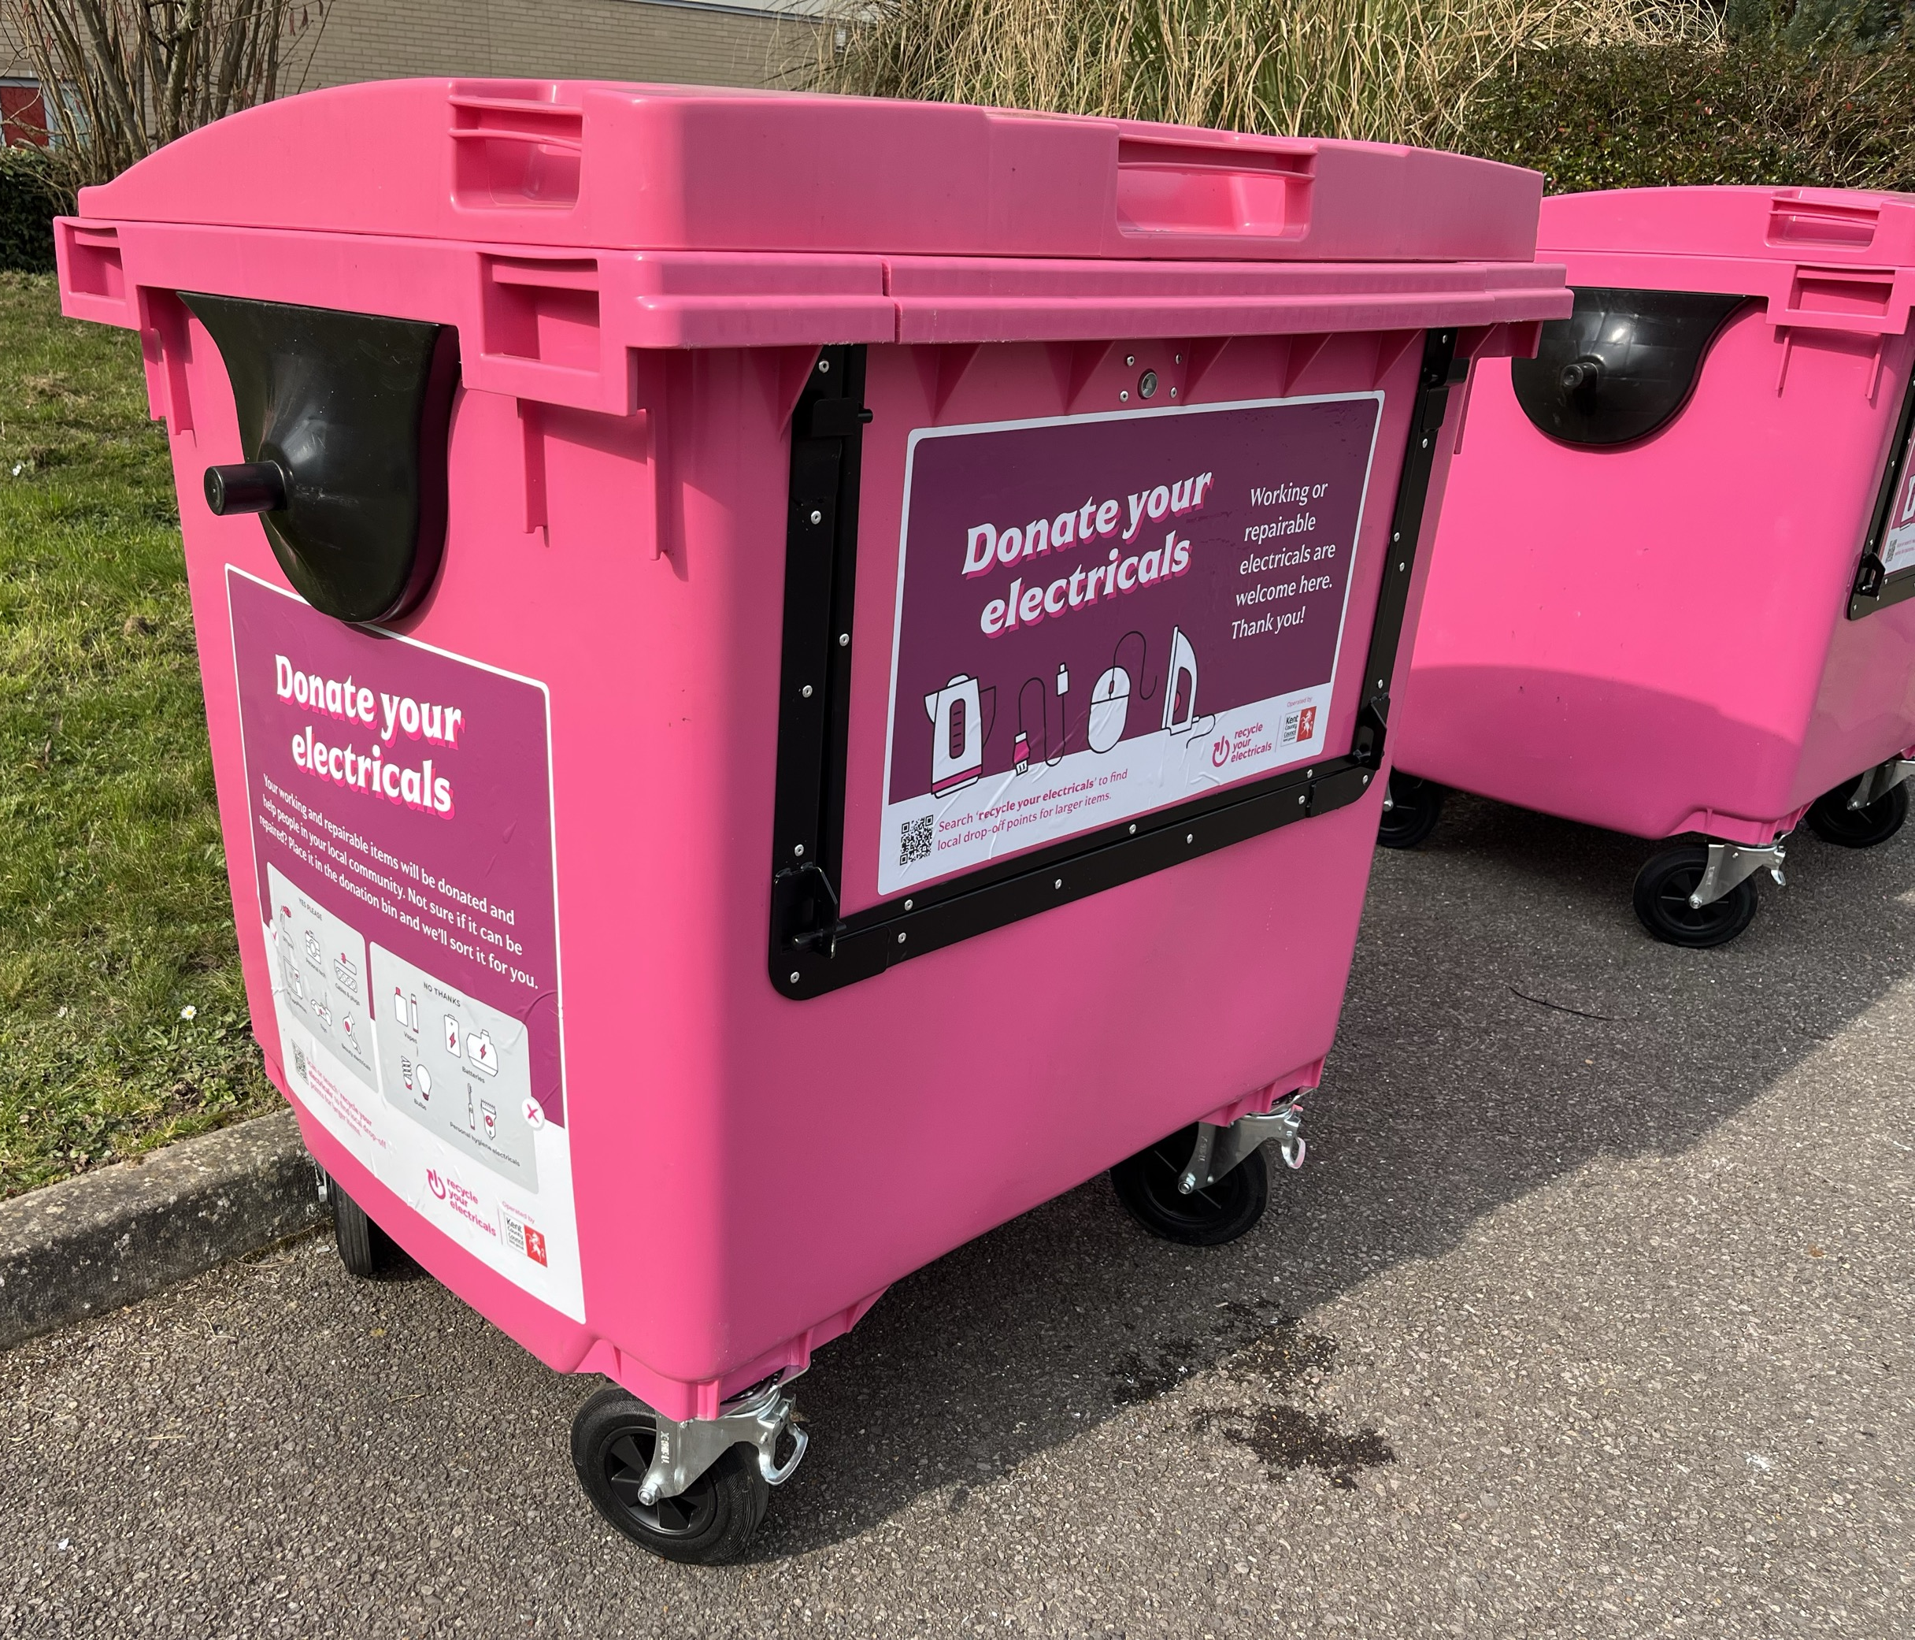
Activity time: e-Waste Warriors
We’re encouraging students to hunt for old electricals buried deep in drawers and cupboards.
Collect - Ask a grown-up to help you
Check - Test them and remove batteries
Recycle them – Place them in the pink recycling or donation bin

Slide 22
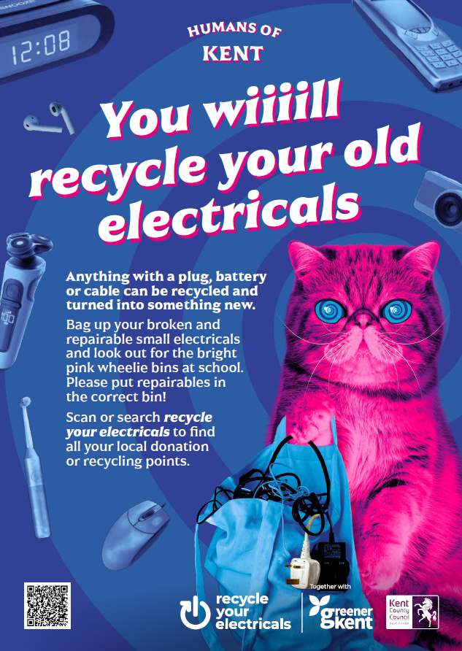
The Competitions!
Working as a group of schools in Thanet
Most weight of recycled electricals wins £200 of vouchers!

Slide 23


Slide 24
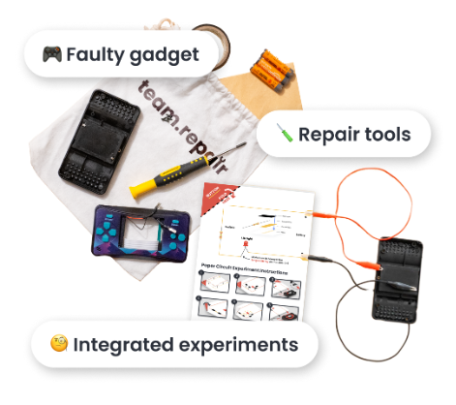

Team Repair activities
Exciting activity
Find the faults
Learn how to repair
Test the games console!

