Slide 1
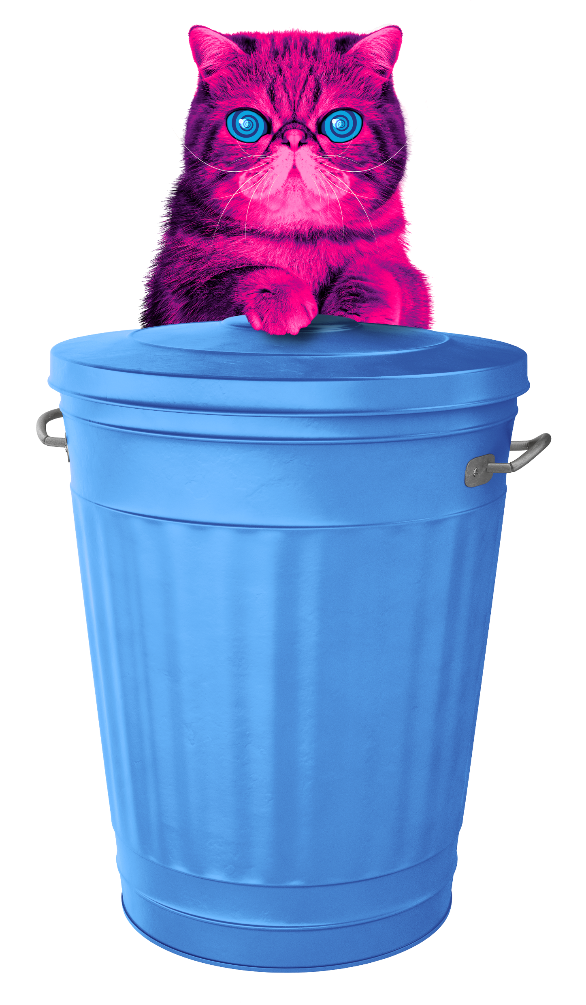
WEEE
Waste electricals and electronic equipment

Slide 2

e-Waste Warriors
17th November – 12th December 2025
Presented by Rich Izzard​​
Kent County Council

Slide 3
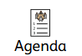
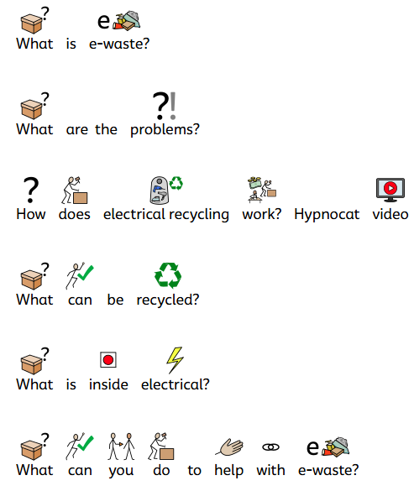




Agenda
What is e-waste?
What are the problems?
How does electrical recycling work video
What can be recycled?
What is inside electricals?
What can you do to help with e-waste

Slide 4

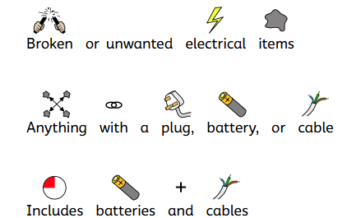



What is e-waste?
Notes:
Notes:
Ask the audience: So what is e-waste and why should we focus on it?
E-waste is one of the fastest growing sources of waste in the world - and in the UK!
This means we are all throwing away more and more electricals.

Slide 5
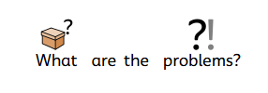
What are the problems?
Notes:
Notes:
Ask the audience: So what is e-waste and why should we focus on it?
E-waste is one of the fastest growing sources of waste in the world - and in the UK!
This means we are all throwing away more and more electricals.

Slide 6
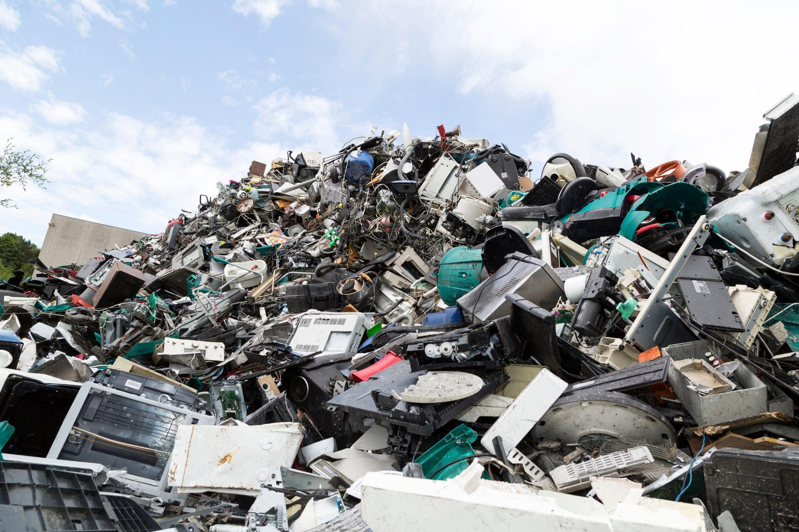
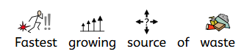
Fastest growing source of waste
Notes:
Notes:
Electrical waste is the fastest growing sources of waste in the world, and in the UK.
It’s growing faster than fast fashion.
That is why we are here to get the UK reusing, repairing, donating and recycling their old unwanted electricals.

Slide 7
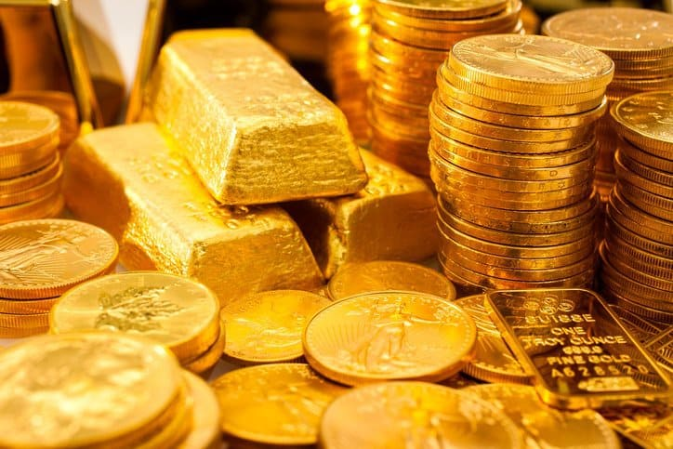
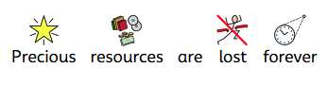
Precious resources are lost forever
Notes:
Notes:
Lost resources
As we mentioned before electricals are made up of different parts and components.
Electricals contain valuable materials such as copper, iron, gold, platinum and palladium
If old electricals go to landfill, or are flytipped instead of being recycled, valuable resources are lost forever. That’s a big problem.
Discarded or hoarded household electricals cost the UK economy £370 million per year of lost valuable raw materials
When the raw materials of batteries are recovered, they can be reused for other purposes or to make new things. For example, the lithium in some batteries could power thousands of electric cars!

Slide 8
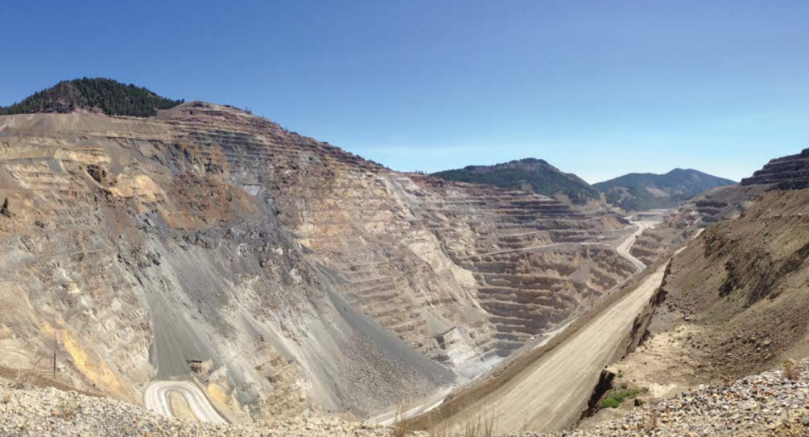

Environmental Damage
Notes:
Notes:
When we lose those precious resources it means new materials have to be found.
This involved mining for new metals
Mining new metals creates millions of CO2 emissions which damages our environment
If we used recycled metals to make new products, 86% less CO2 emissions would be released.
Image - an example of a large open pit copper mine

Slide 9
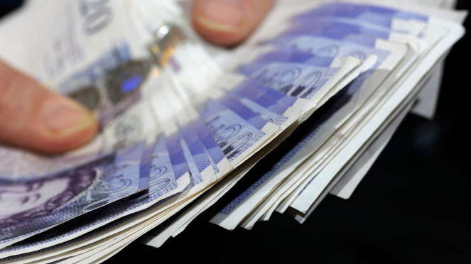
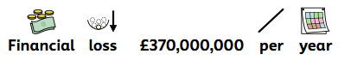
Financial loss £370,000,000 per year!
Notes:
Notes:
Discarded or hoarded household electricals cost the UK economy £370 million per year of lost valuable raw materials such as gold, copper, aluminium and steel.
Many electrical items that are thrown away can actually be donated
That includes your kettle, toys or laptops
The average UK household is hiding away 20 unwanted electricals
If we passed these on to charities they could make a big difference to people’s lives
Processed recycled electricals become commodities to buy and sell

Slide 10
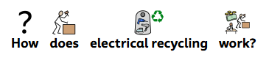
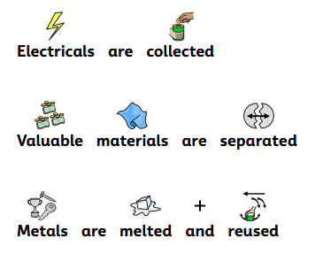
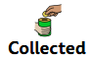
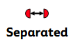
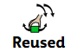
How does electrical recycling work?
Electricals are collected
Valuable materials are separated
Metals are melted and reused
Collected
Separated
Reused
Collected
Separated
Reused

Slide 11

How

Slide 12
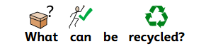

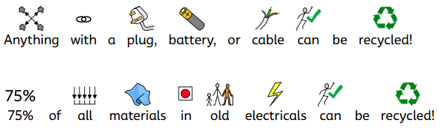
What can be recycled?
Anything with a plug, battery, or cable can be recycled!
75% of all materials in old electricals can be recycled!
Notes:
Notes:
Did you know a typical iPhone contains precious metals like gold, silver, platinum, aluminium and copper!
The recycled metals from old electricals can be transformed into anything from bicycles to children’s playgrounds
Even the batteries and cables themselves can be recycled

Slide 13
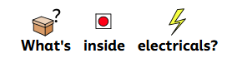
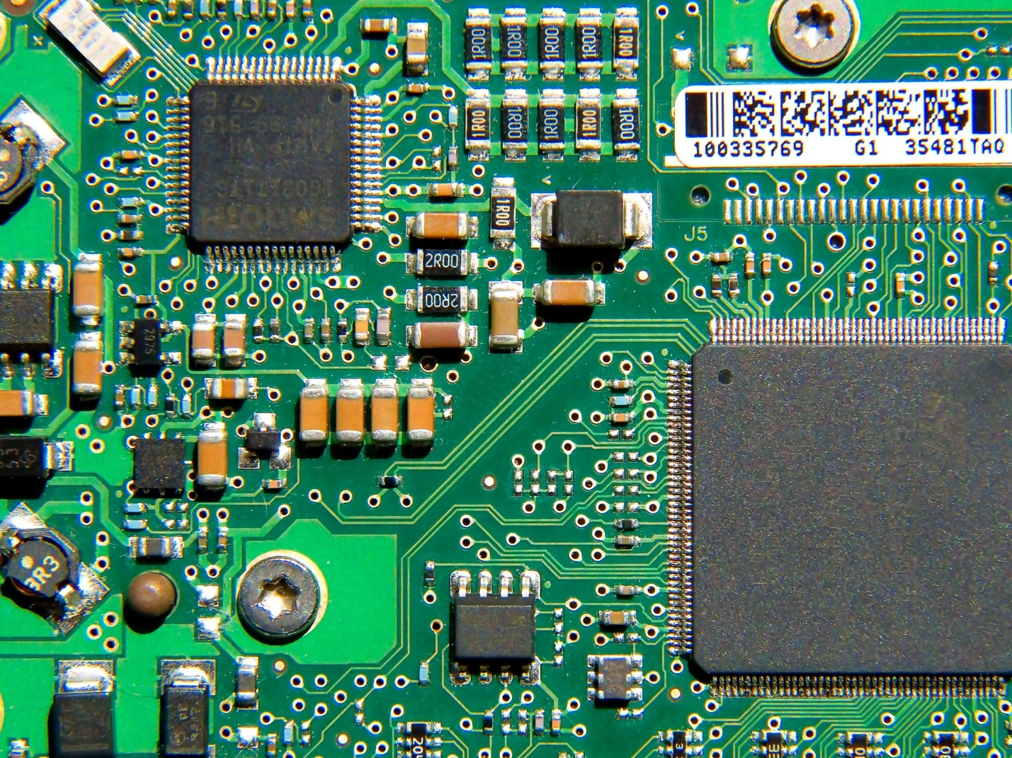
What’s inside electricals?
Notes:
Notes:
Did you know a typical iPhone contains precious metals like gold, silver, platinum, aluminium and copper!
The recycled metals from old electricals can be transformed into anything from bicycles to children’s playgrounds
Even the batteries and cables themselves can be recycled

Slide 14


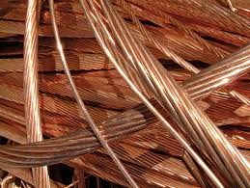
What’s inside electricals?
Notes:
Notes:
Did you know a typical iPhone contains precious metals like gold, silver, platinum, aluminium and copper!
The recycled metals from old electricals can be transformed into anything from bicycles to children’s playgrounds
Even the batteries and cables themselves can be recycled

Slide 15
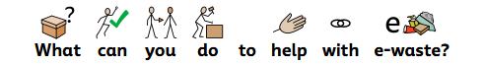

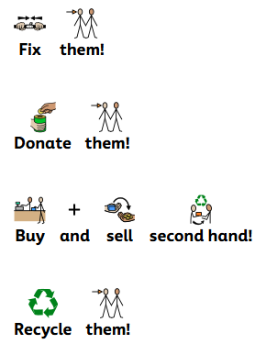



What can you do to help with e-waste?
Fix them!
Donate them!
Buy and sell second hand!
Recycle them!
Notes:
Notes:
Ask the audience: So what is e-waste and why should we focus on it?
E-waste is one of the fastest growing sources of waste in the world - and in the UK!
This means we are all throwing away more and more electricals.

Slide 16
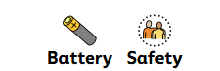
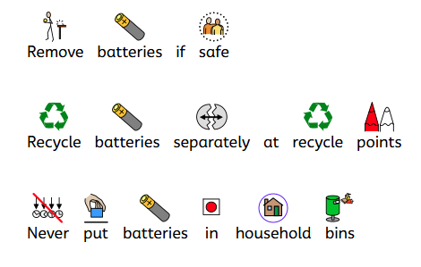

Battery Safety
Remove batteries if safe
Recycle batteries separately at recycle points
Never put batteries in household bins
Notes:
Notes:
Ask the audience: So what is e-waste and why should we focus on it?
E-waste is one of the fastest growing sources of waste in the world - and in the UK!
This means we are all throwing away more and more electricals.

Slide 17
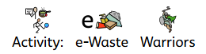
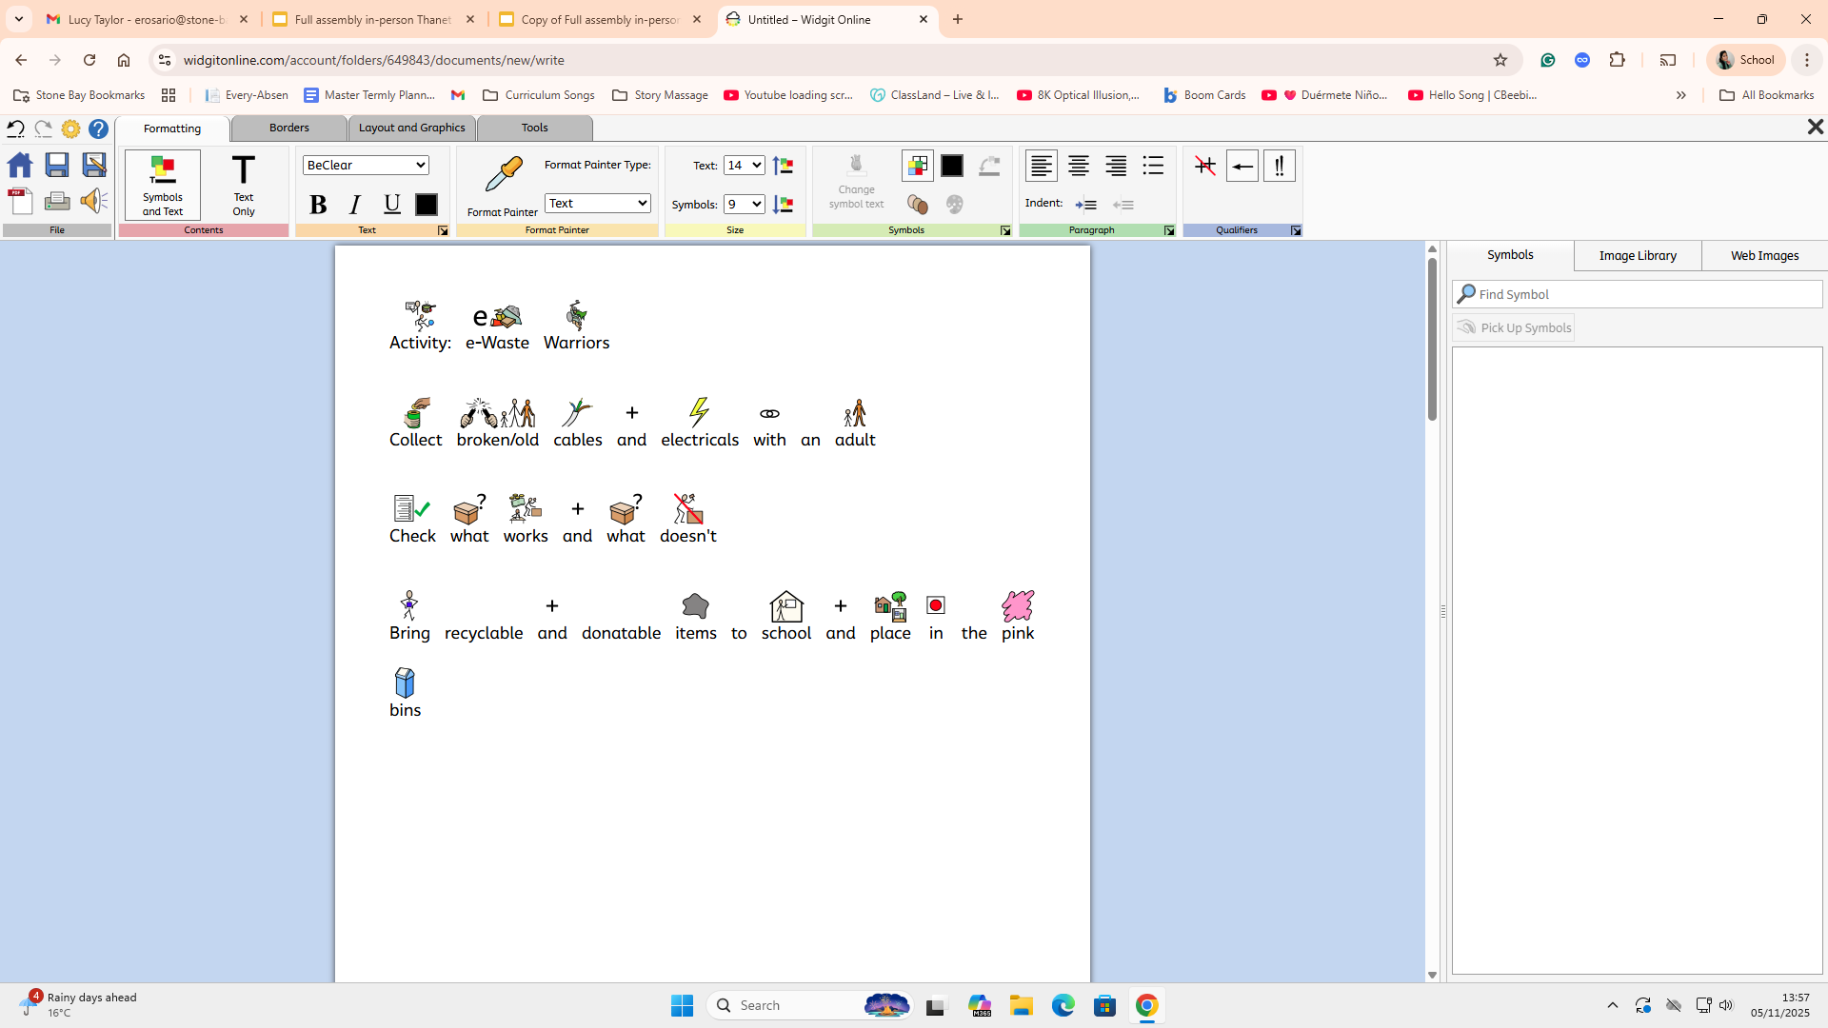
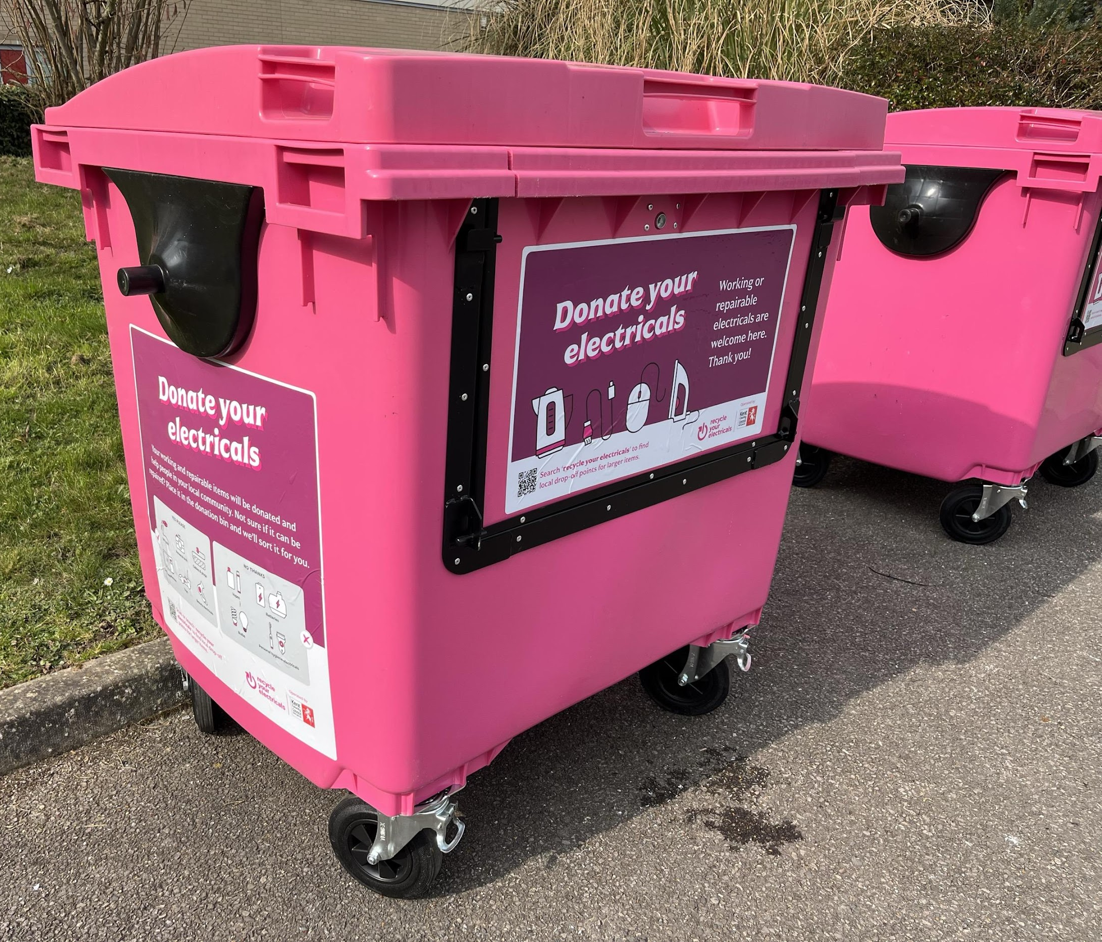
Activity: e-Waste Warriors
Collect broken/old cables and electricals with an adult
Check what works and what doesn’t
Bring recyclable and donatable items to school and place in the pink
bins
Notes:
Notes:
Ask the audience: So what is e-waste and why should we focus on it?
E-waste is one of the fastest growing sources of waste in the world - and in the UK!
This means we are all throwing away more and more electricals.

Slide 18
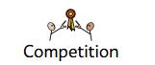
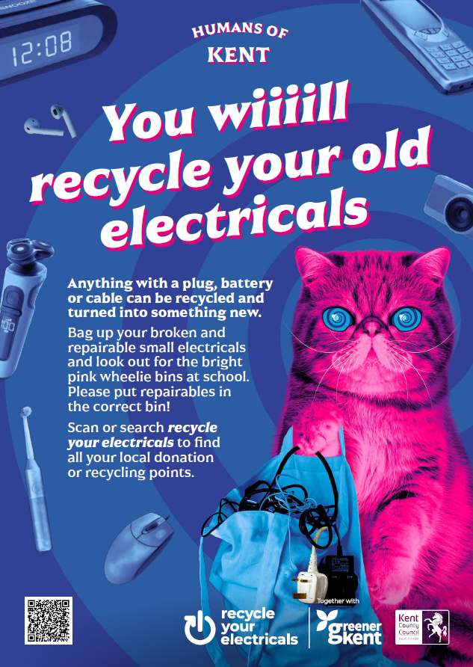
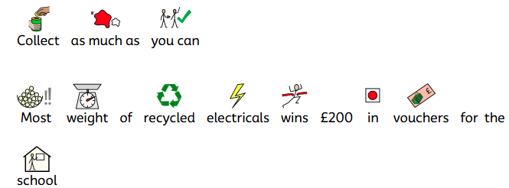
Competition
Collect as much as you can
Most weight of recycled electricals wins £200 in vouchers for the
school
Notes:
Notes:
Ask the audience: So what is e-waste and why should we focus on it?
E-waste is one of the fastest growing sources of waste in the world - and in the UK!
This means we are all throwing away more and more electricals.

Slide 19
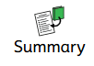
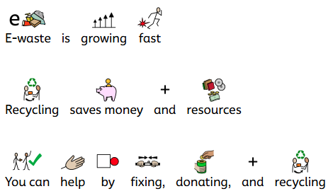
Summary
E-waste is growing fast
Recycling saves money and resources
You can help by fixing, donating, and recycling
Notes:
Notes:
Ask the audience: So what is e-waste and why should we focus on it?
E-waste is one of the fastest growing sources of waste in the world - and in the UK!
This means we are all throwing away more and more electricals.

Slide 20


Slide 21

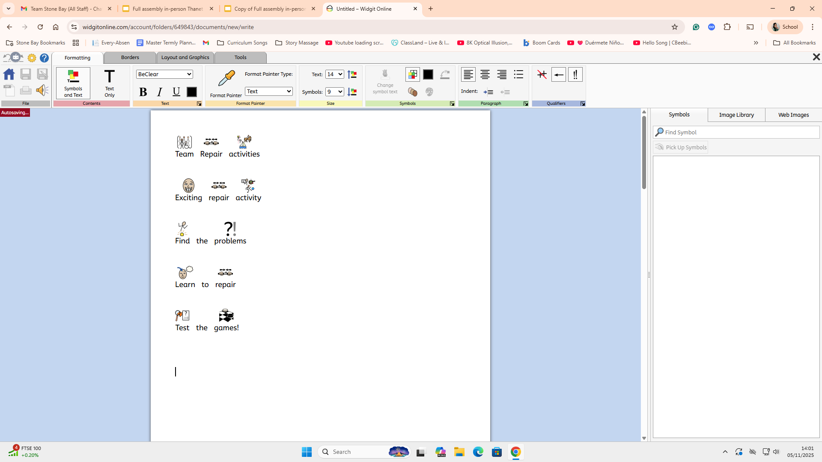
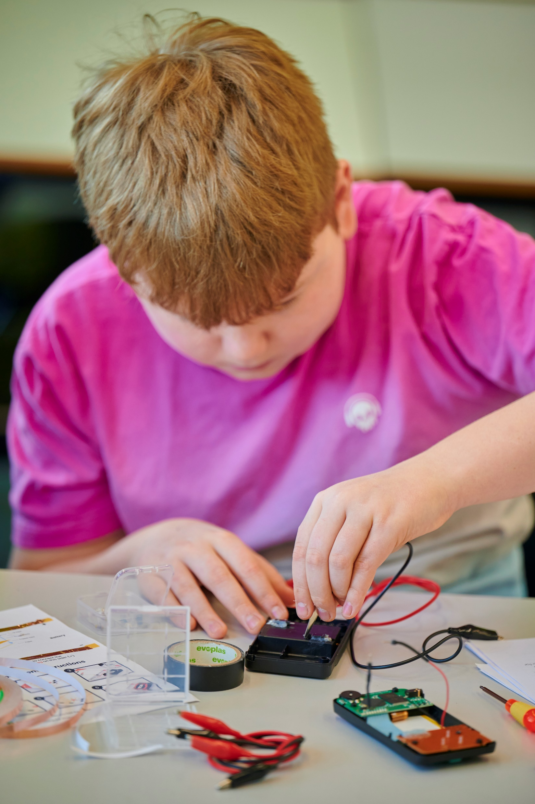
Team Repair Activities
Exciting repair activity
Find the problems
Learn to repair
Test the games!
Notes:
Notes:
Ask the audience: So what is e-waste and why should we focus on it?
E-waste is one of the fastest growing sources of waste in the world - and in the UK!
This means we are all throwing away more and more electricals.

